Slide 1

Web Standardisation
Web Development 1

Slide 2
Web Standarisation?
Web standards are the technologies we use to build websites.
These standards exist as long technical documents called specifications
Specificatons detail exactly how the technology should work.
These documents are not very useful for learning how to use the technologies they describe
This is why we have sites like MDN Web Docs
They are intended to be used by software engineers to implement these technologies (usually in web browsers).

Slide 3
HTML Living Standard
For example, the HTML Living Standard describes exactly how HTML (all the HTML elements, and their associated APIs, and other surrounding technologies) should be implemented.
https://html.spec.whatwg.org/multipage/

Slide 4
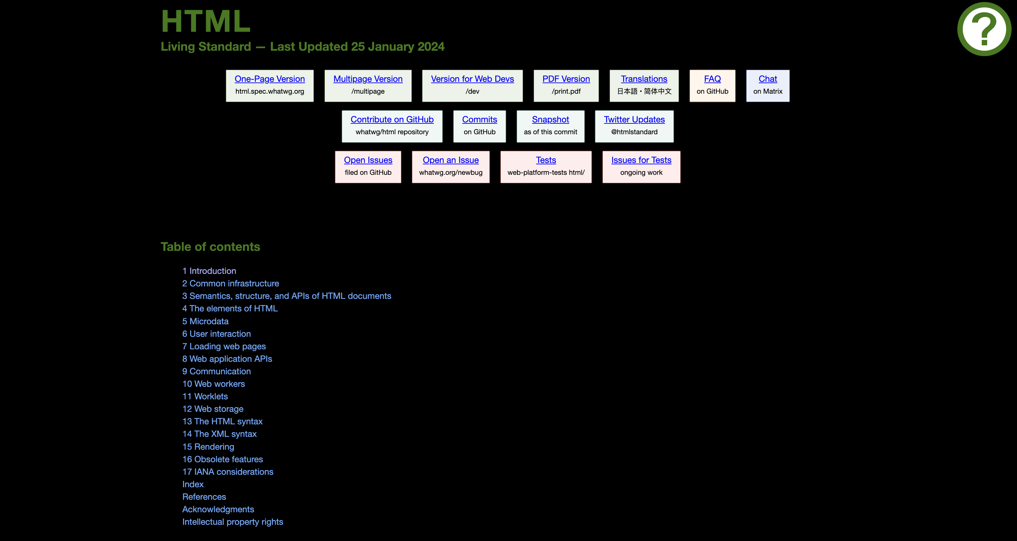

Slide 5
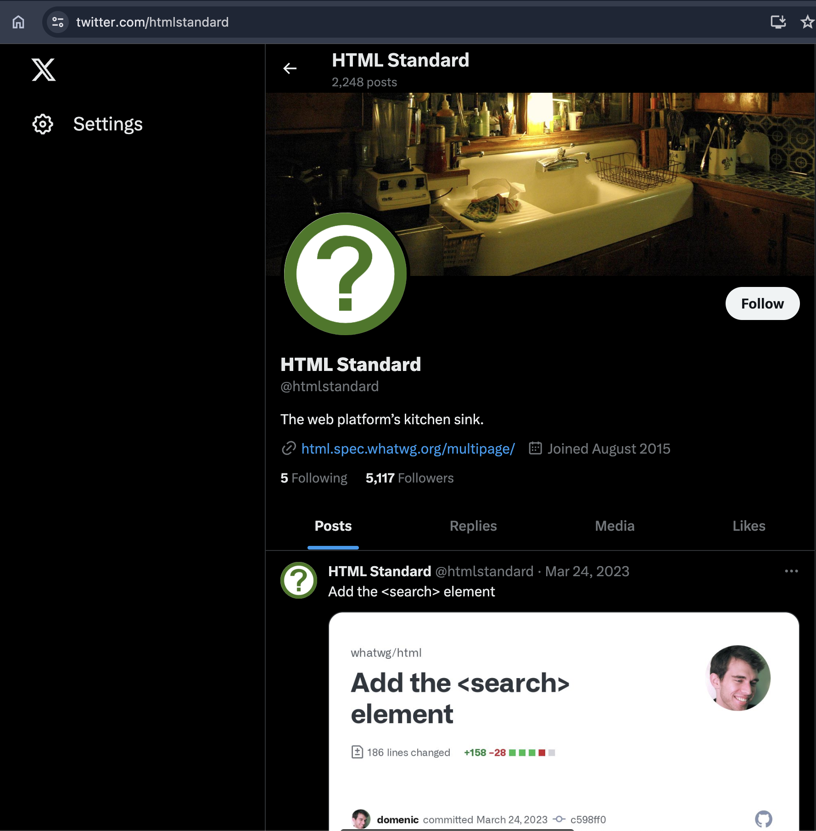

Slide 6

Who owns this standard?

Slide 7

Web Hypertext Application Technology Working Group
WHATWG (WHAT-W-G) is a community of people interested in evolving HTML and related technologies.
Founded by individuals from Apple Inc., the Mozilla Foundation and Opera Software, leading Web browser vendors in 2004.

Slide 8
Web Hypertext Application Technology Working Group
WHATWG is responsible for maintaining multiple web-related technical standards, including the specifications for the HyperText Markup Language (HTML) and the Document Object Model (DOM).
The central organizational membership and control of WHATWG – its "Steering Group" – consists of Apple, Mozilla, Google, and Microsoft.
WHATWG community members work with the editor of the specifications to ensure correct implementation.

Slide 9
Web Hypertext Application Technology Working Group
The WHATWG was formed in response to the slow development of World Wide Web Consortium (W3C) Web standards and W3C's decision to abandon HTML in favour of XML-based technologies (XHTML)
On 28 May 2019, the W3C announced that WHATWG would be the sole publisher of the HTML and DOM standards

Slide 10
Web Hypertext Application Technology Working Group
The HTML Living Standard
Sometimes informally called HTML5.
The HTML specification has been a living document without version numbers since 2011.It includes both HTML, the core markup language for the web, and a number of related APIs.
The DOM Standard
defines how the Document Object Model on the web is supposed to work and replaces W3C DOM level 3. For example, it replaces mutation events with mutation observers.
Fetch Standard
”Defines requests, responses, and the process that binds them: fetching."
The fetch standard defines the 'fetch' JavaScript API, and supersedes the HTML5 fetch functionality, CORS and the HTTP Origin header semantics.
The Encoding Standard
Defines how character encodings such as Windows-1252 and UTF-8 are handled in web browsers and is intended to replace the IETF encodings registry.
The MIME type sniffing standard
Defines how MIME types are supposed to be sniffed in web browsers.
The URL standard
defines how URLs are supposed to be parsed in web browsers.
WEB IDL
used to describe interfaces that are intended to be implemented in web browsers
The Streams Standard
Provides APIs for creating, composing, and consuming streams of data.

Slide 11
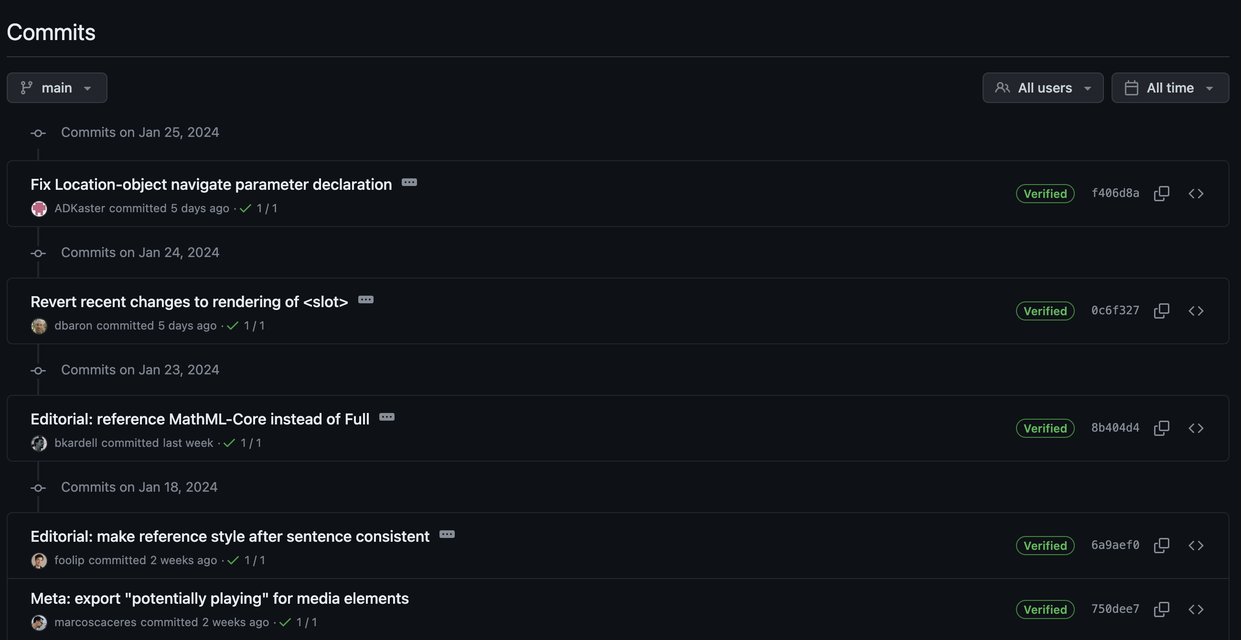
https://github.com/whatwg/html/commits

Slide 12

Standards & Design Progress Together
2004

Slide 13

Standards & Design Progress Together
2009

Slide 14

Standards & Design Progress Together
2018

Slide 15

Standards & Design Progress Together
2024

Slide 16
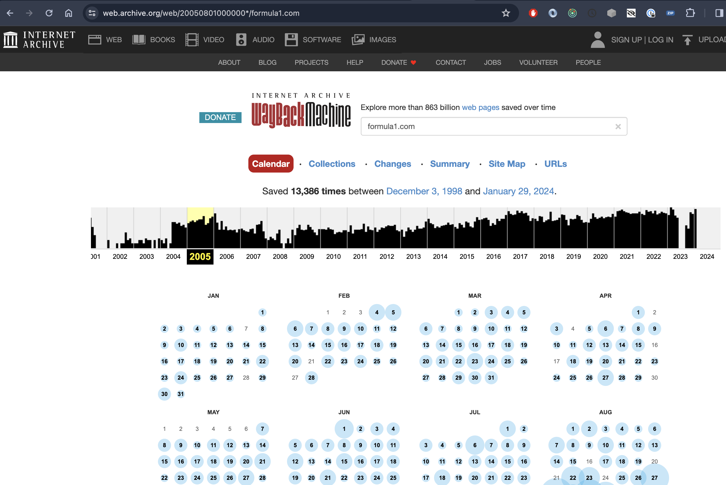

Slide 17

The other players….

Slide 18

World Wide Web Consortium
The World Wide Web Consortium (W3C) is the main international standards organization for the World Wide Web.
Founded in 1994 and led by Tim Berners-Lee, the consortium is made up of member organizations that maintain full-time staff working together in the development of standards for the World Wide Web.
As of 5 March 2023, W3C had 462 members.
W3C also engages in education and outreach, develops software and serves as an open forum for discussion about the Web.

Slide 19

Internet Engineering Task Force
The Internet Engineering Task Force (IETF) is a standards organization for the Internet and is responsible for the technical standards that make up the Internet protocol suite (TCP/IP).
It has no formal membership roster or requirements and all its participants are volunteers.
Their work is usually funded by employers or other sponsors.
The IETF was initially supported by the federal government of the United States but since 1993 has operated under the auspices of the Internet Society, a non-profit organization with local chapters around the world.

Slide 20
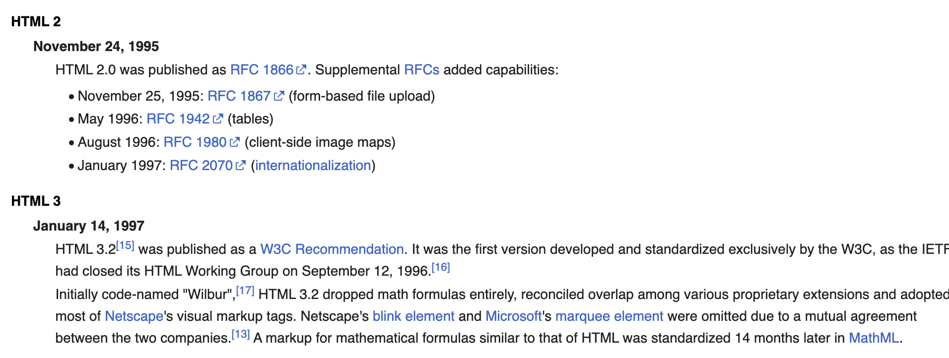
HTML Timeline

Slide 21
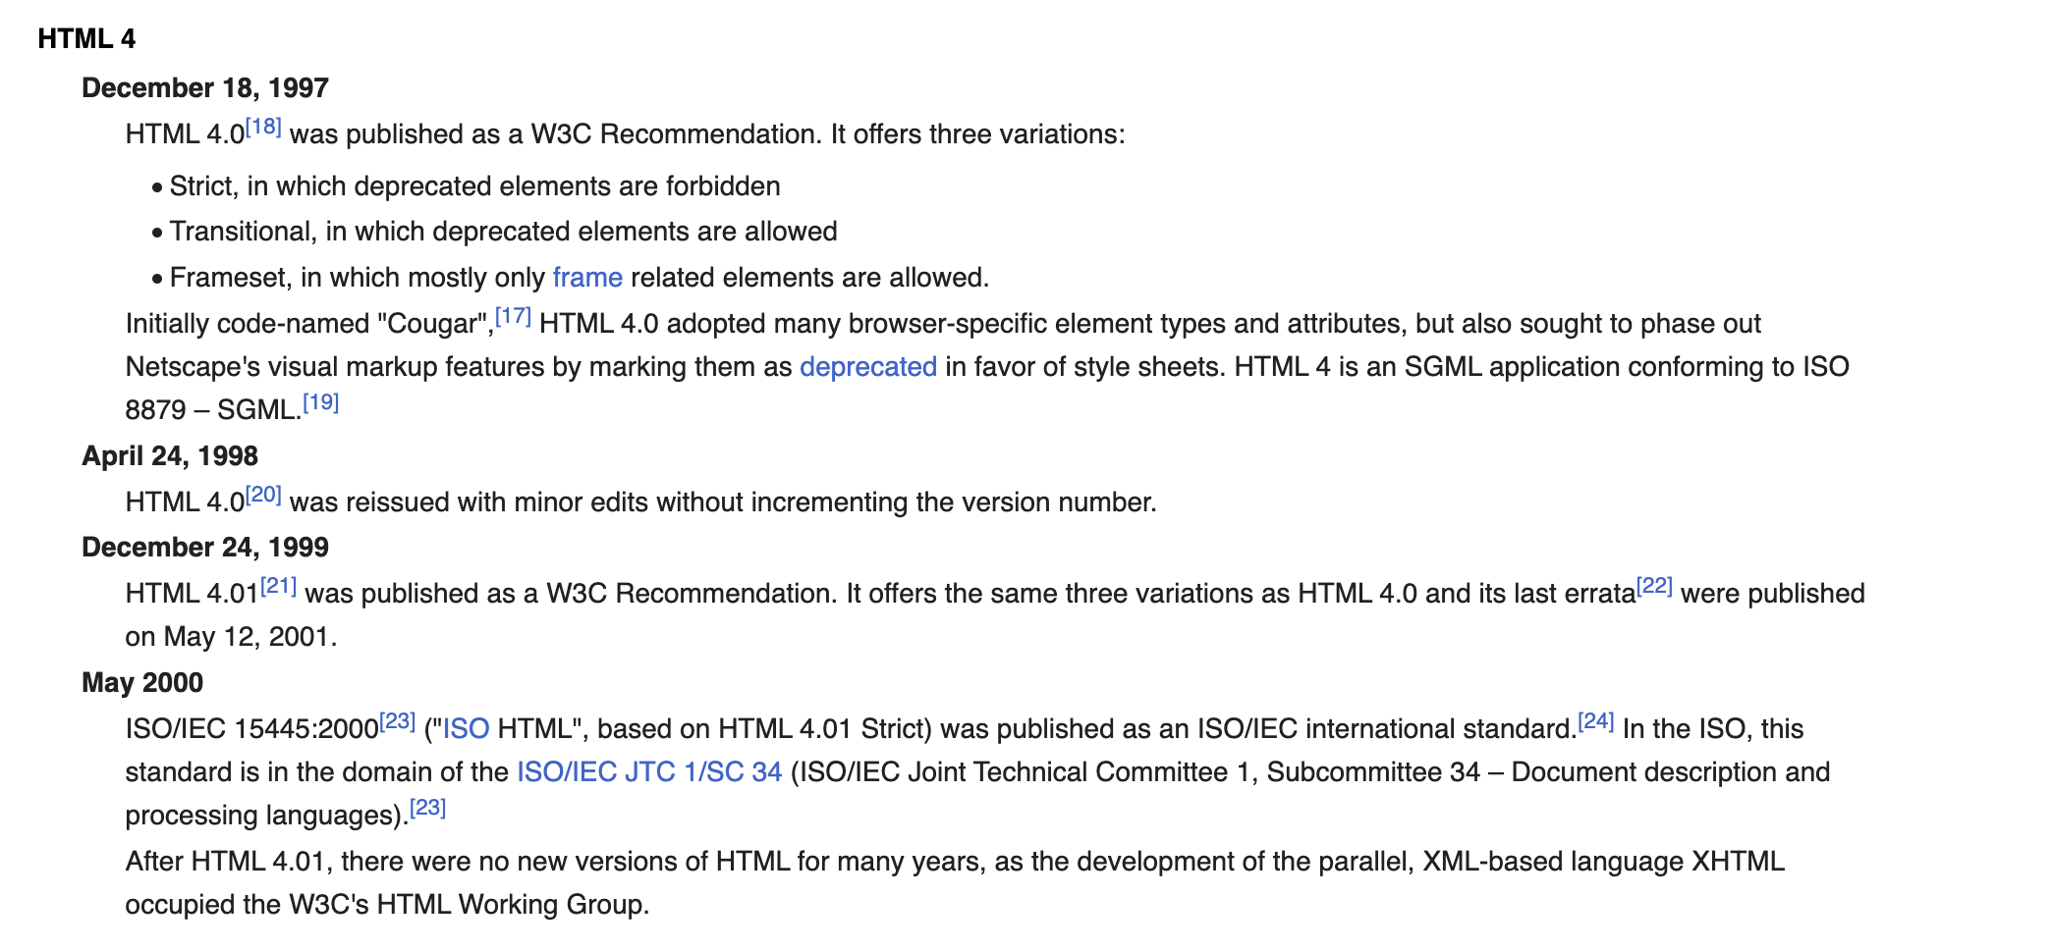
HTML Timeline

Slide 22
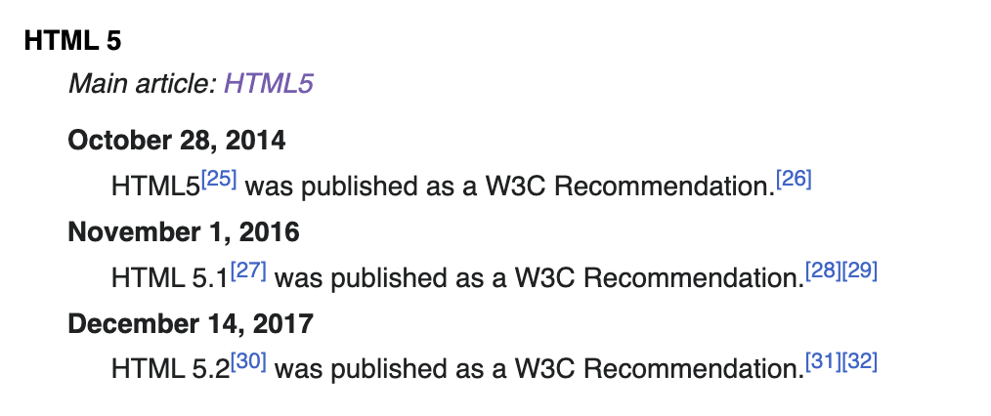
HTML Timeline
https://en.wikipedia.org/wiki/HTML

Slide 23
When will there be a HTML6?
HTML5 was Retired on 27 March 2018
Additionally, the retirement included HTML 4.0, HTML 4.01, XHTML 1.0, and XHTML 1.1.
HTML 5.1, HTML 5.2 and HTML 5.3 were all retired on 28 January 2021, in favour of the HTML living standard.
https://html.spec.whatwg.org/multipage/

Slide 24
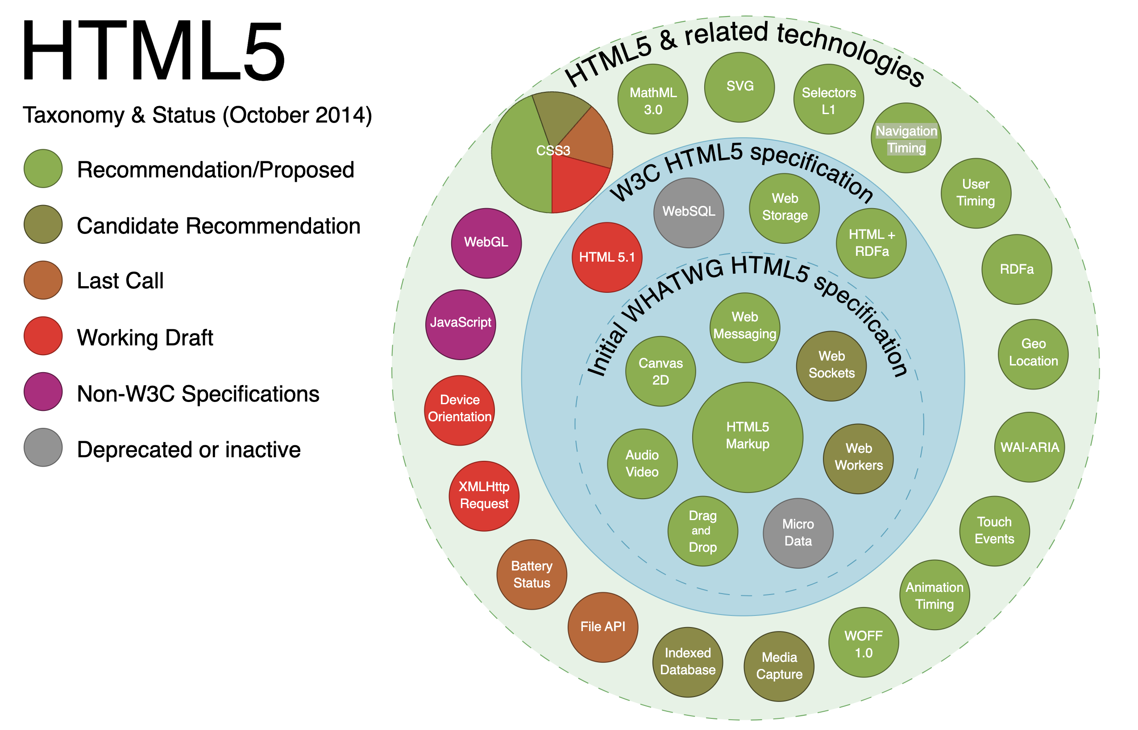

Slide 25
CSS 3 & 4?
CSS 3 is divided into several separate documents called "modules".
Each module adds new capabilities or extends features defined in CSS 2, preserving backward compatibility.
Work on CSS level 3 started around the time of publication of the original CSS 2 recommendation.
The earliest CSS 3 drafts were published in June 1999.
Due to the modularization, different modules have different stability and statuses
There is no single, integrated CSS4 specification, because the specification has been split into many separate modules which level independently.

Slide 26
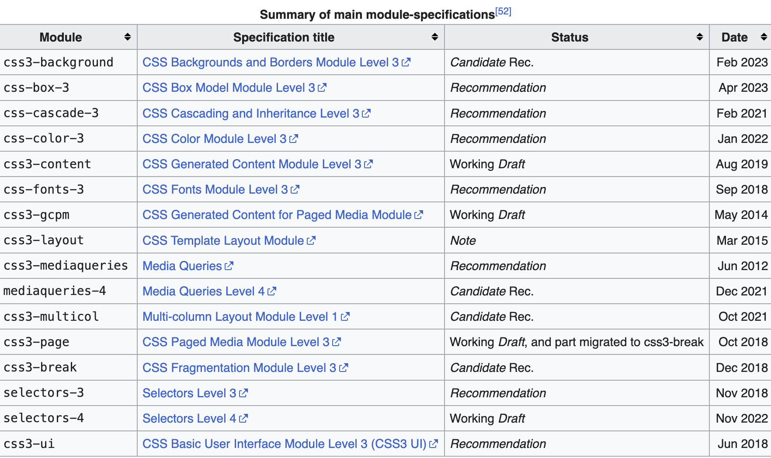
CSS 3

Slide 27
Selectors
Selectors Level 3
https://www.w3.org/TR/selectors-3/
Selectors Level 4
https://www.w3.org/TR/selectors-4/

Slide 28
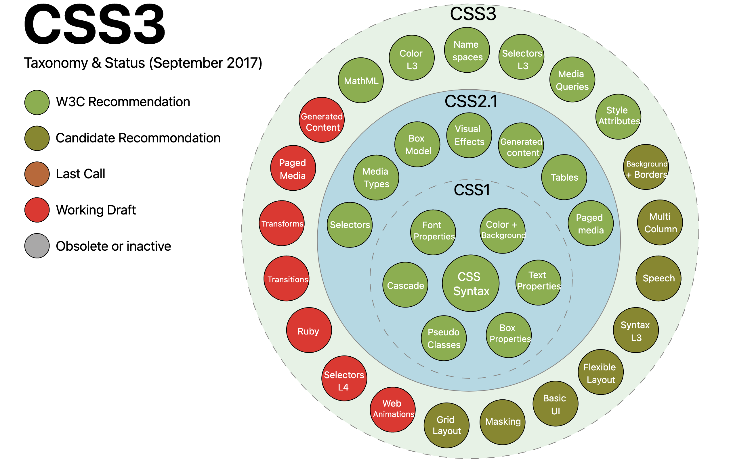

Slide 29
ECMA and JavaScript?
ECMA?
European Computer Manufacturers Association
JavaScript
ECMAScript is a standard for scripting languages, including JavaScript, JScript, and ActionScript. It is best known as a JavaScript standard intended to ensure the interoperability of web pages across different web browsers. It is standardized by Ecma International in the document ECMA-262.

